Slide 1
PERIODIC
FURNITURE STYLES
ADARSH RAJENDRAN
FACULTY OF ARCHITECTURE
GPTC ADOOR

Slide 2
QUEEN ANNE FURNITURE
The Queen Anne style of furniture design developed before, during, and after the reign of Anne, Queen of Great Britain (1702–1714).
Influenced by Queen Anne herself, this style was known for its simplicity in curved lines. Overstuffed upholstered pieces and chairs without stretchers were types of furniture that were influenced by this style. Although simple and delicate, I would use this furniture with similar wooden pieces that convey elegance.

Slide 3
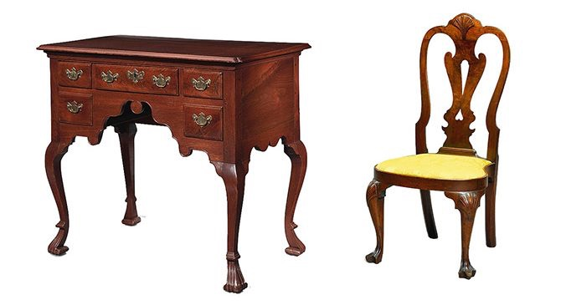

Slide 4
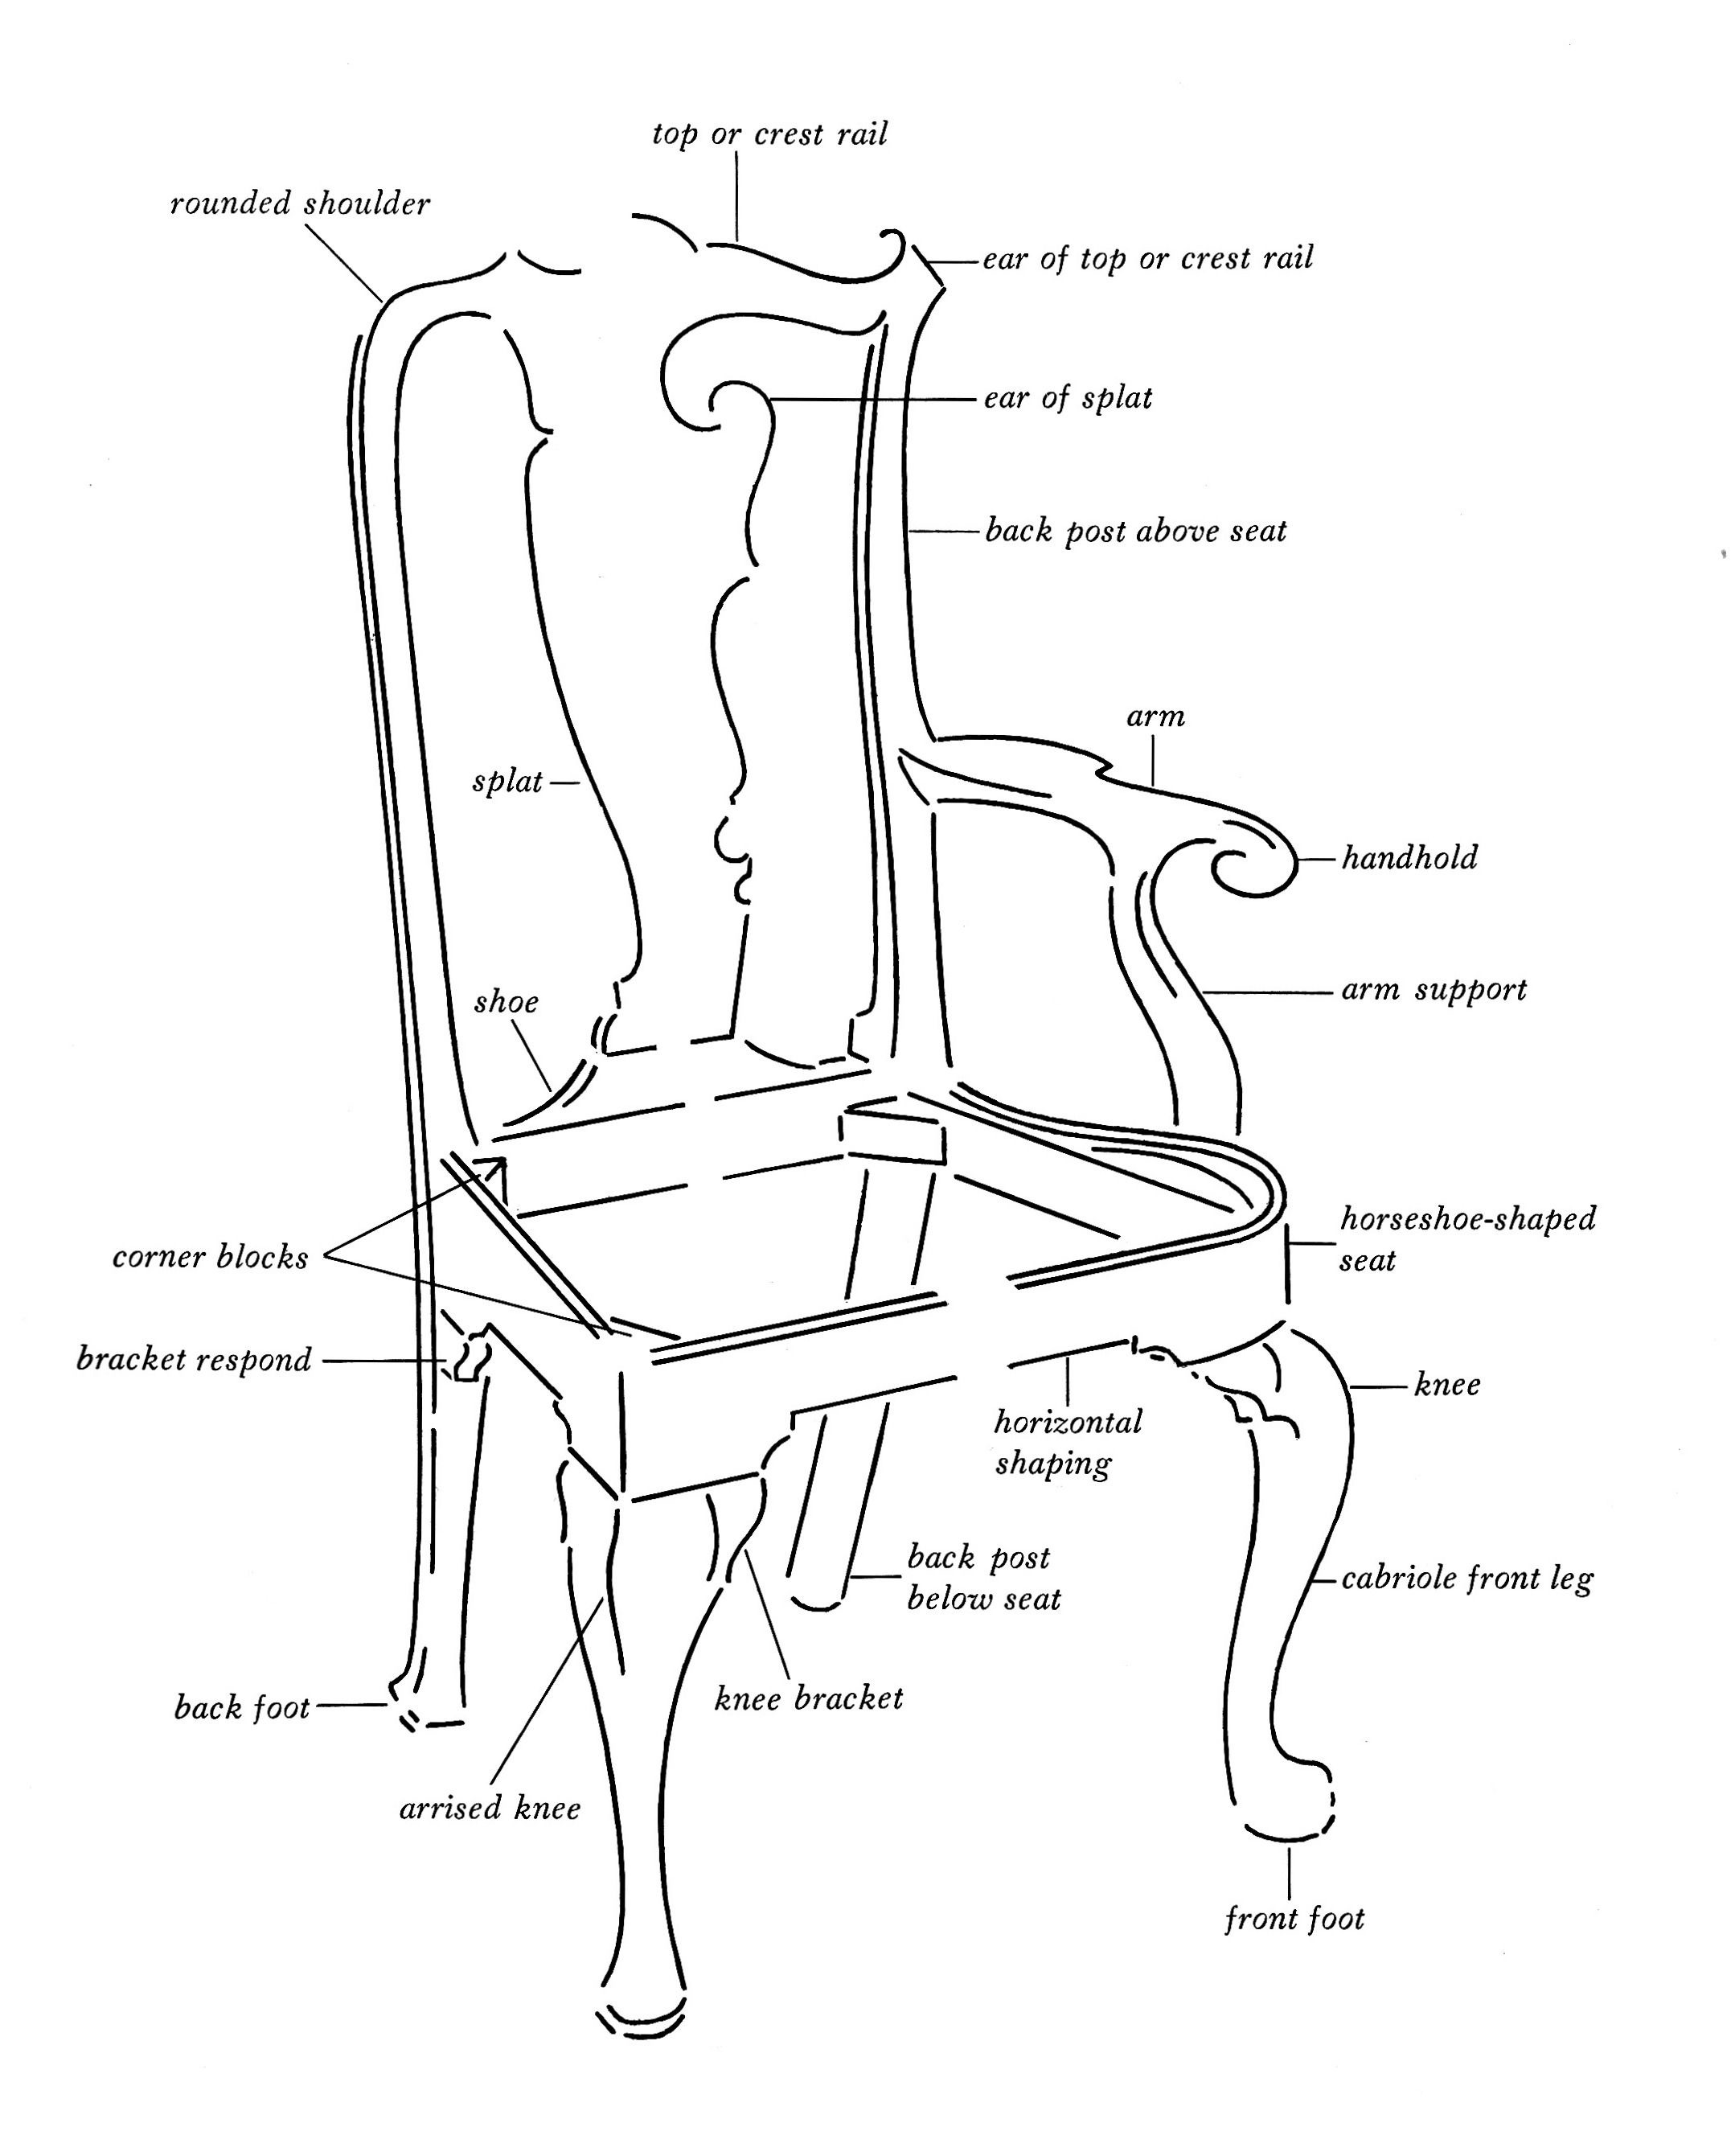

Slide 5
Chippendale Furniture
Named after Thomas Chippendale, this furniture was popular between 1760 to 1785. This style was a combination of lesser styles that included French and Rocco. They are known for the natural designs and images of birds, leaves, fruits and flowers. Popular features included the square leg in furniture and classic curved fronts on chests of drawers. When using this chair, we would convey a classic and elegant feel.

Slide 6
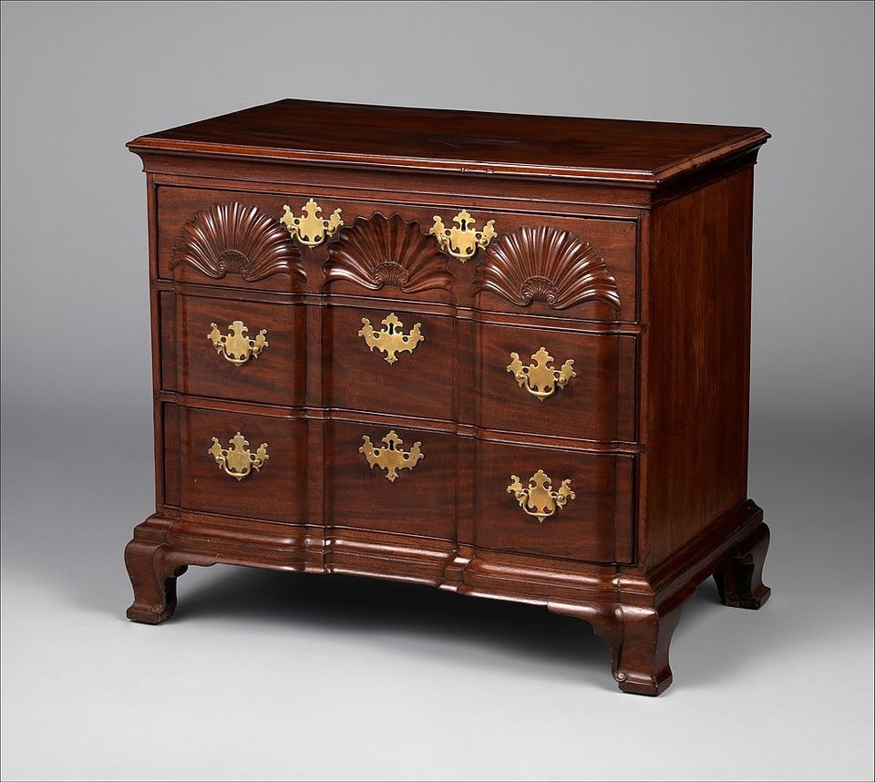

Slide 7
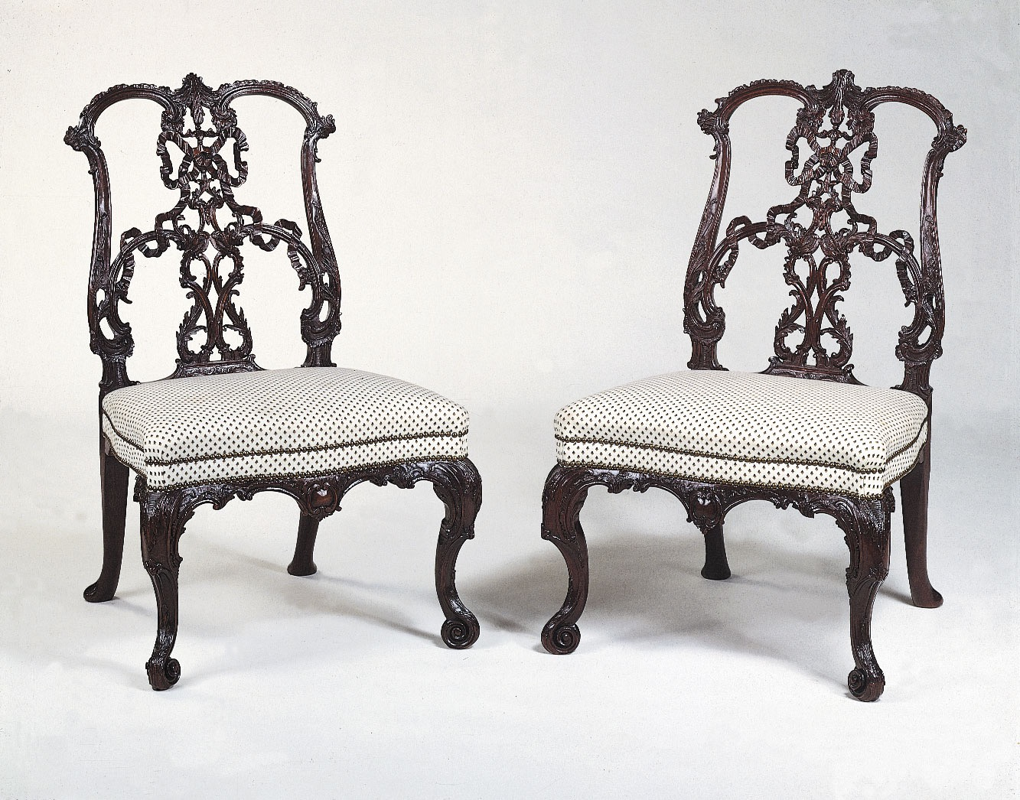

Slide 8
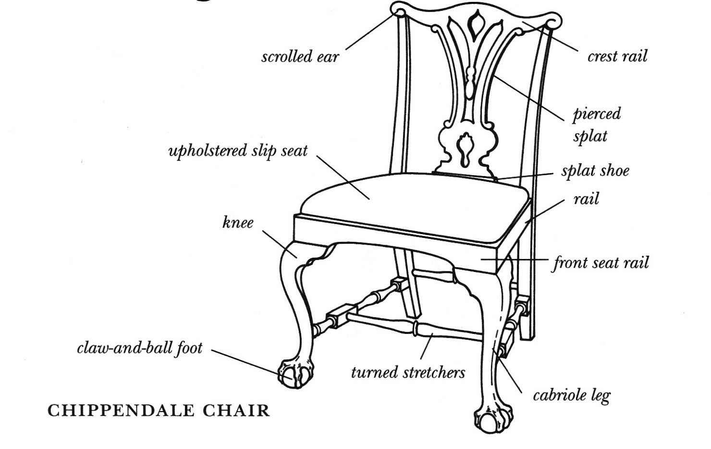

Slide 9
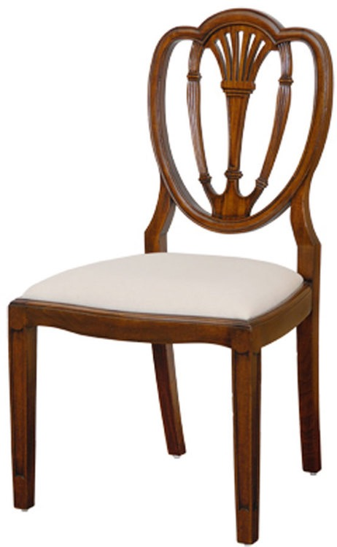
FEDERAL STYLE
This style was prominent from 1785 to 1810 and was marked by elegant simplicity and clear geometric shapes. When using this style, I would not place it with any curved lines, it belongs around simple and geometric shapes in a hallway or entryway.

Slide 10
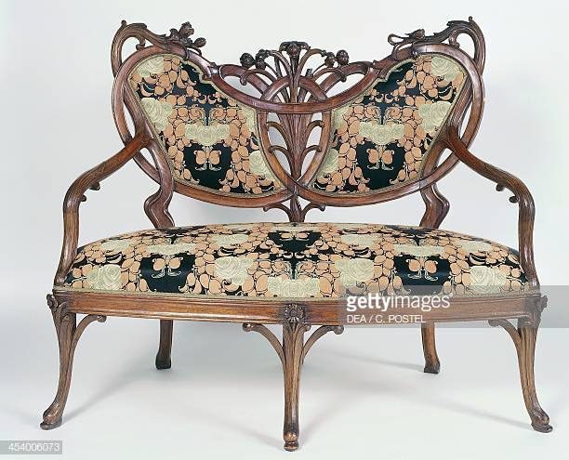
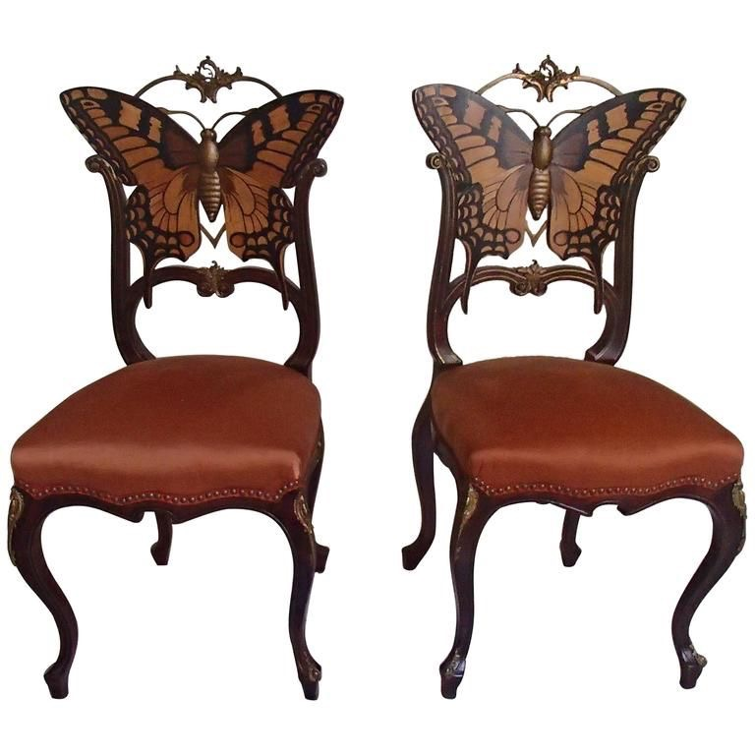
Art Nouveau Furniture
A late nineteenth century to early twentieth century European style, this style of furniture was based off of the patterns of natural forms. For example, branches, leaves, and flames. This piece of furniture would definitely be placed in a simple room with deep woods and curves allowing it to be the focal point.

Slide 11
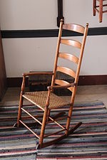
Shaker Furniture
Shaker furniture is a distinctive style of furniture developed by the United Society of Believers in Christ's Second Appearing, commonly known as Shakers, a religious sect that had guiding principles of simplicity, utility and honesty. Their beliefs were reflected in the well-made furniture of minimalist designs.

Slide 12
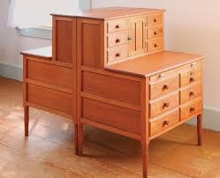
Furniture was made thoughtfully, with functional form and proportion. Rather than using ornamentation such as inlays, carvings, metal pulls, or veneers — which was seen as prideful or deceitful, they developed "creative solutions such as asymmetrical drawer arrangements and multipurpose forms to add visual interest." Furniture was made of cherry, maple or pine lumber, which was generally stained or painted with one of the colors which were dictated by the sect, typically blue, red, yellow or green.

Slide 13
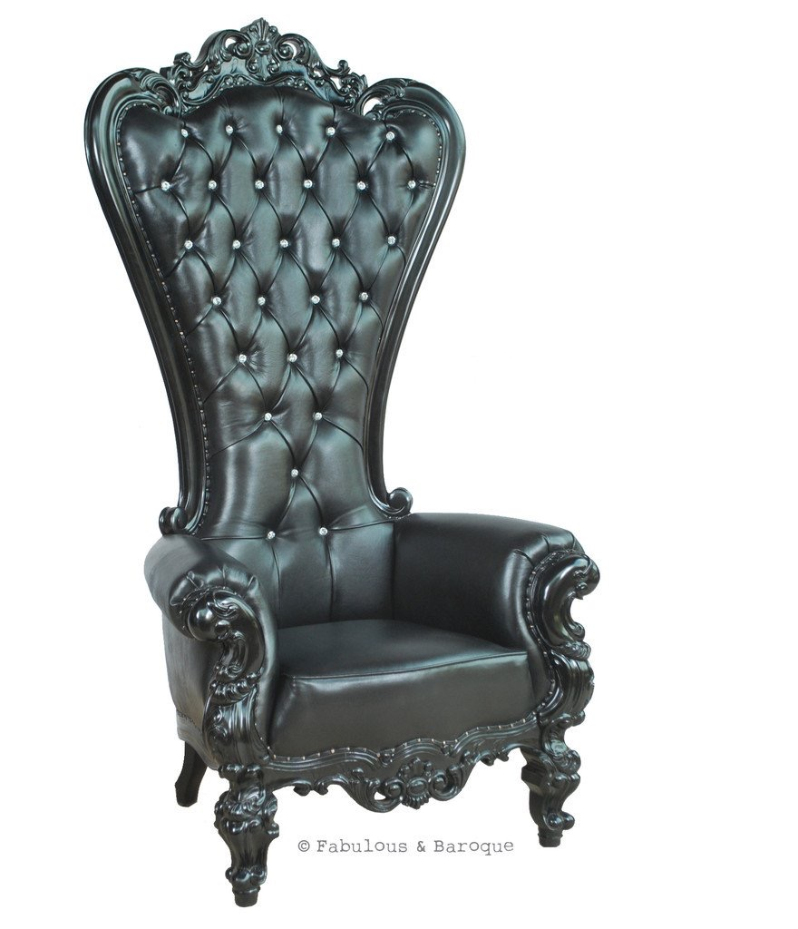
Baroque Furniture
This style emphasised the fullness of size, scale and proportion. It was an Italiano outgrowth of the late Renaissance where the Italians used twisted turnings, broken and reserved curves. Materials used were marble, ivory and bronze. This style presents elaborate detail and symmetrical carvings that mimic the Renaissance period.

Slide 14
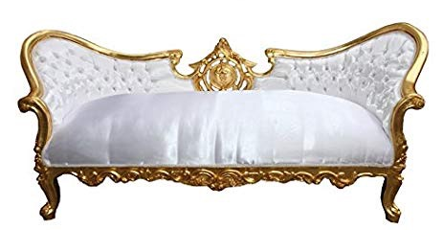
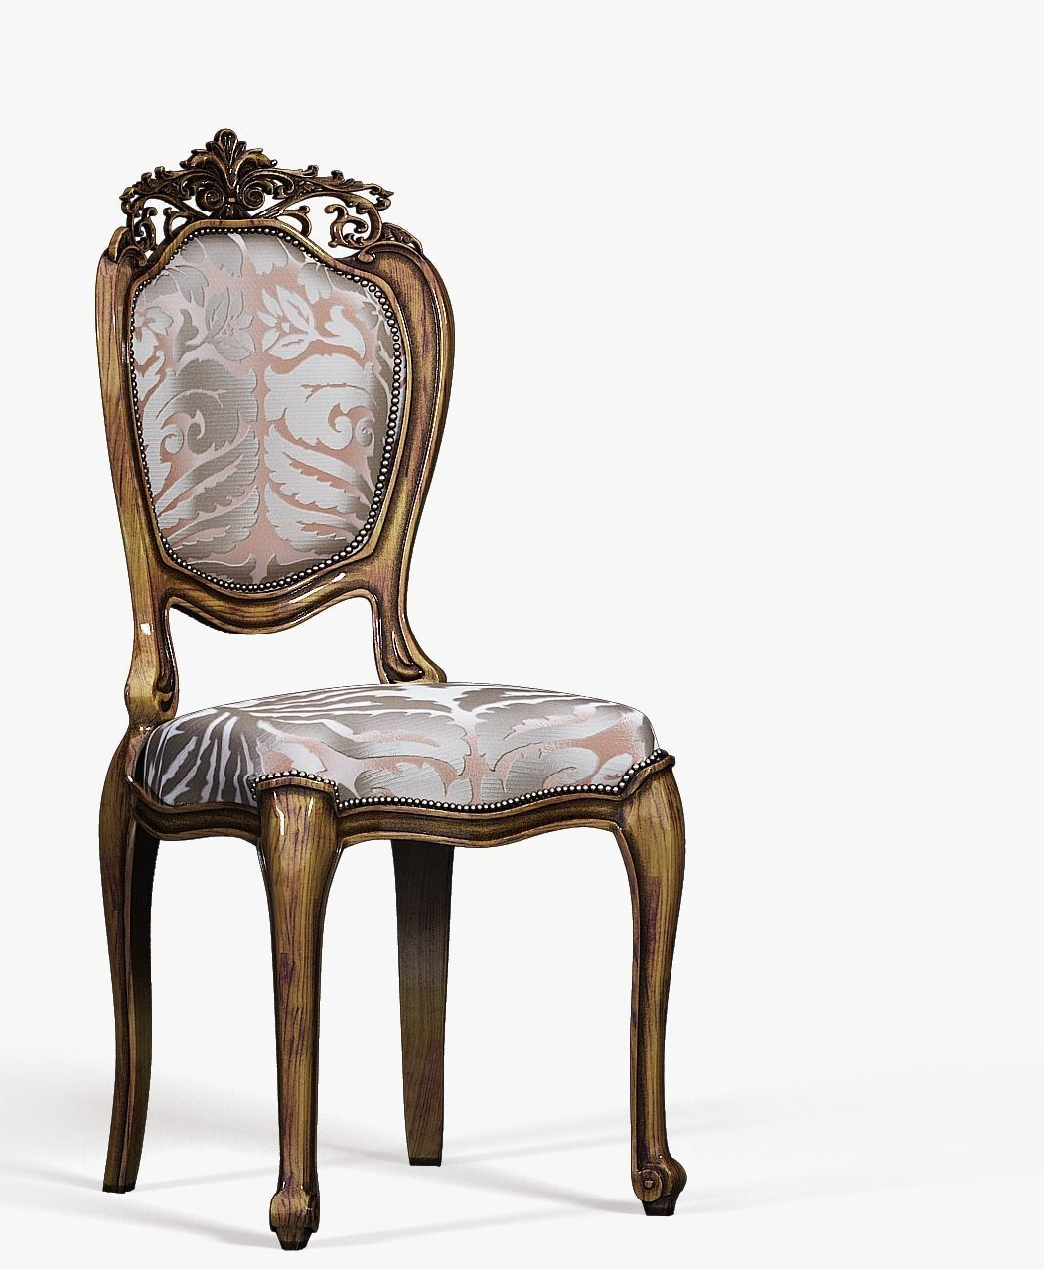
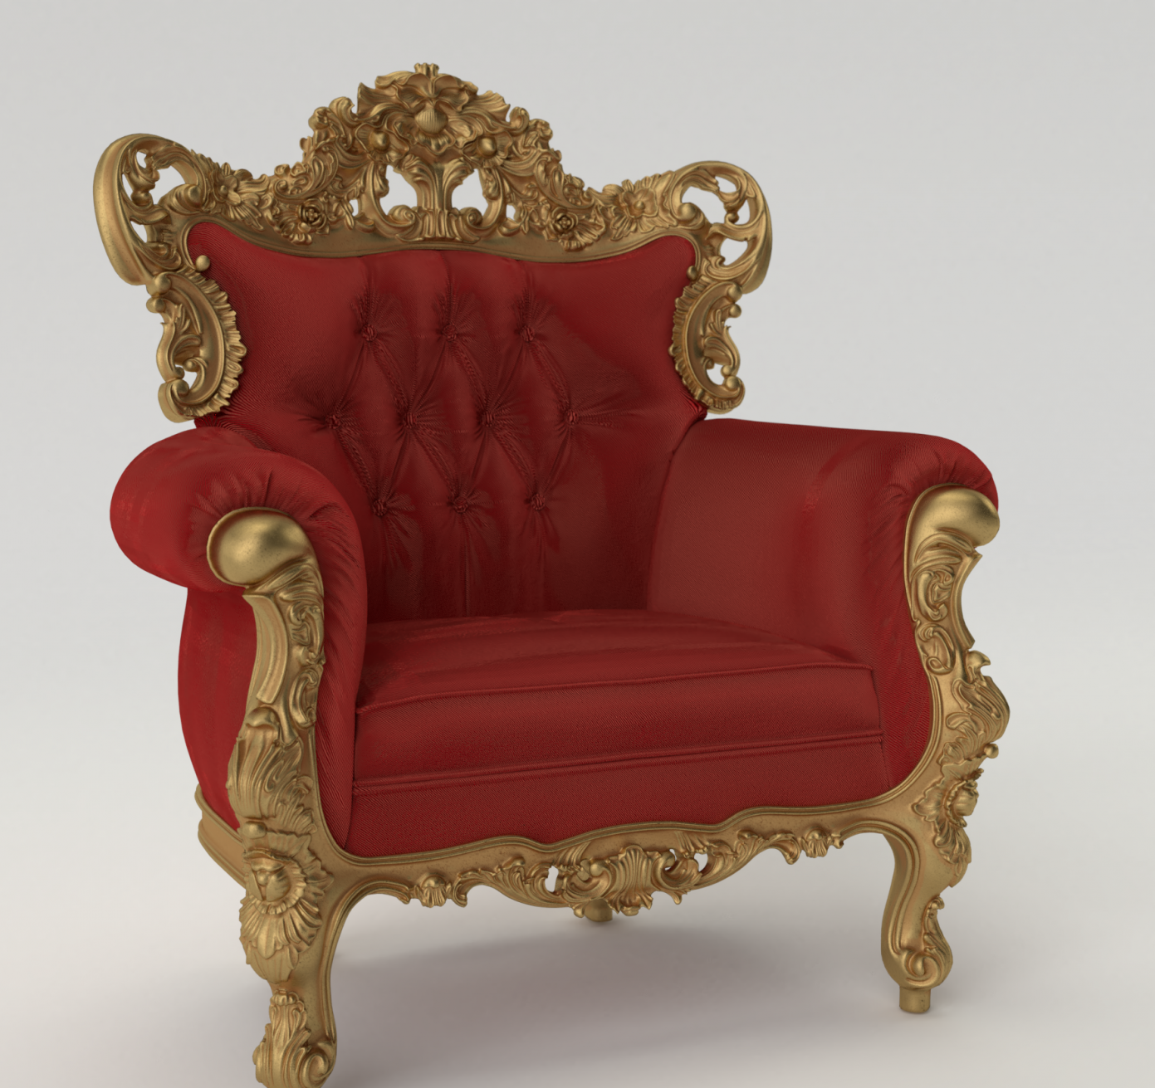
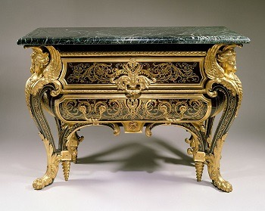

Slide 15
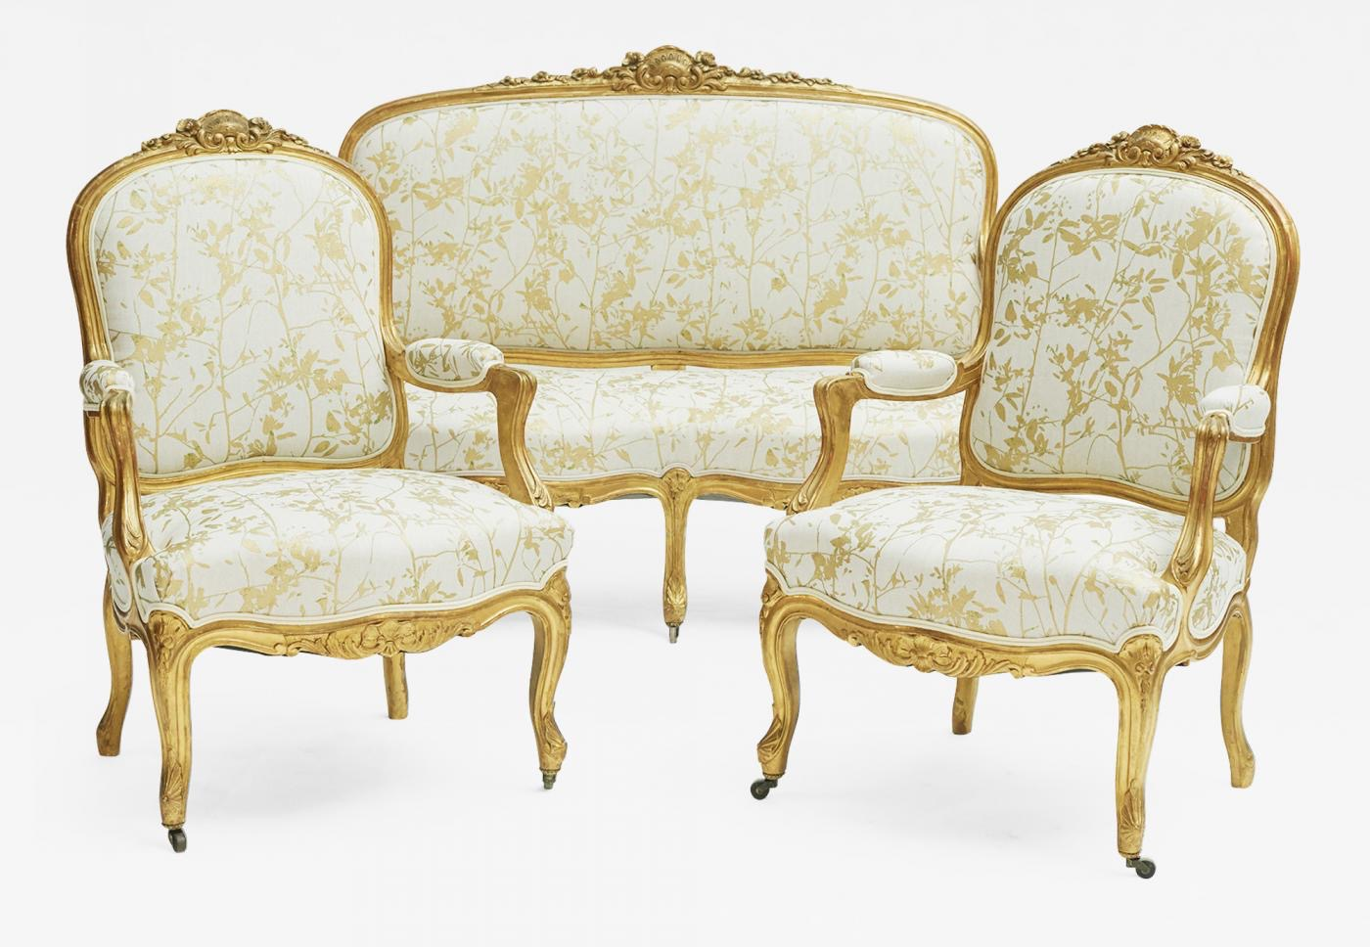
ROCOCO FURNITURE
The Rococo was an artistic movement of the 18th century, in which the wealthy rejected the regal sobriety of the Baroque for a lighter, softer aesthetic. Being an art form of leisure, the Rococo manifested itself perhaps most clearly in decorative arts. In a world where leisure, comfort, and art were all intertwined, furniture reigned supreme.

Slide 16
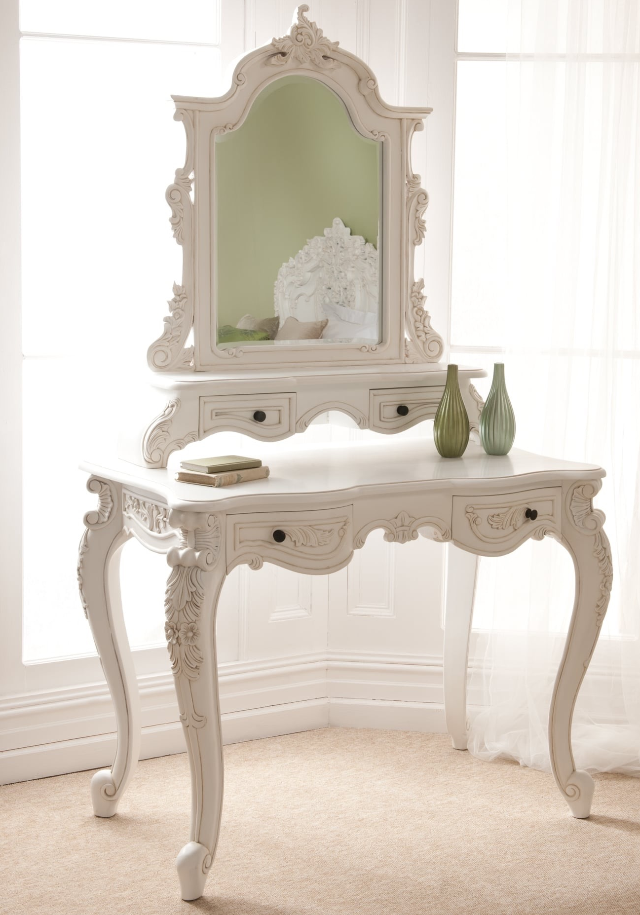
Rococo furniture used lighter woods and pastel colours to create a much softer, airier aesthetic. This visual weightlessness was compounded by removing the grounded traits of Baroque furniture as well. Rococo furniture featured much thinner legs, often relying on an s-like curve called the cabriole leg. The cabriole was modelled after the leg of an animal, perhaps a goat, which also points out another element of the Rococo: organic motifs.

Slide 17
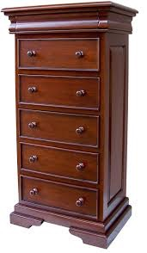
Tall boy chest
A tallboy is a piece of furniture incorporating a chest of drawers and a wardrobe on top. A highboy consists of double chest of drawers (a chest-on-chest), with the lower section usually wider than the upper. the highboy has five, six, or seven long drawers, and some times two short ones.

Slide 18
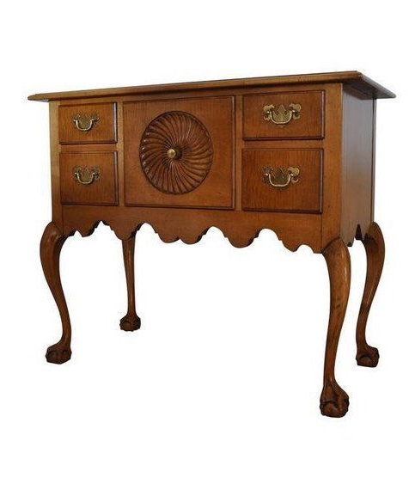
LOW BOY
A lowboy is an American collectors term for one type of dressing table, vanity, or duchess. It is a small table with one or two rows of drawers, so called in contradistinction to the tallboy or highboy chest of drawers.

